Slide 1
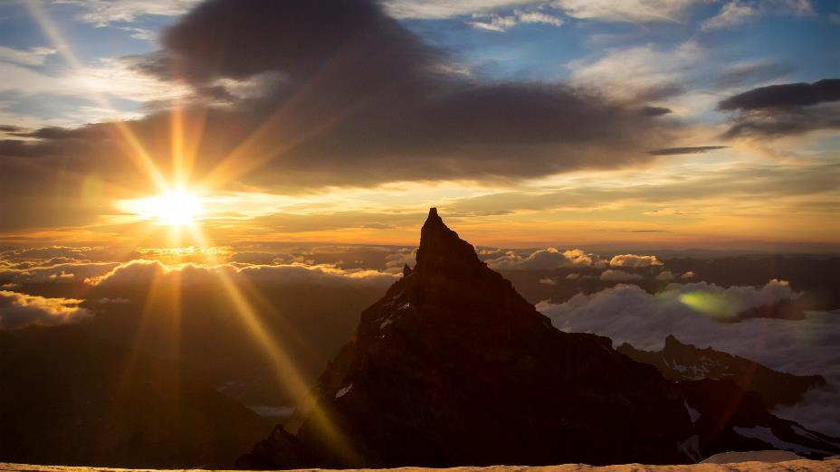
Ideas for keeping camera clubs active during
COVID-19 social distancing
November 2, 2020
w.NECCC.org/keeping-clubs-active
Organized by NECCC.org
Host - Chane Cullens
Chane@CCullens.com

Slide 2
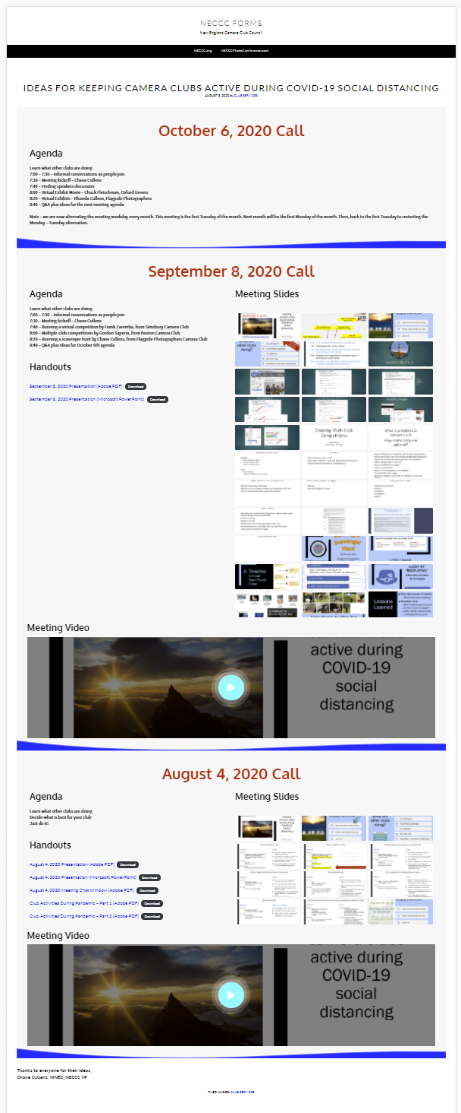
Share this site with your club members
Slides
Recording
http://w.neccc.org/keeping-clubs-active

Slide 3
Agenda - October 6, 2020
7:00 – 7:30 – informal conversations as people join
7:30 – Meeting kickoff – Chane Cullens
7:35 – Antoinette Gombeda, NECCC President – Honors …
7:45 – Rhonda Cullens, NECCC VP Club Services Packet and Publicity – A few club services that are now free
7:55 – Open discussion on what is working or not working at their clubs

Slide 4

More club Services are now free!
NECCC.org – Club Services Tab
Rhonda Cullens, MNEC
NECCC VP Club Services Packet & Publicity
November 2, 2020

Slide 5
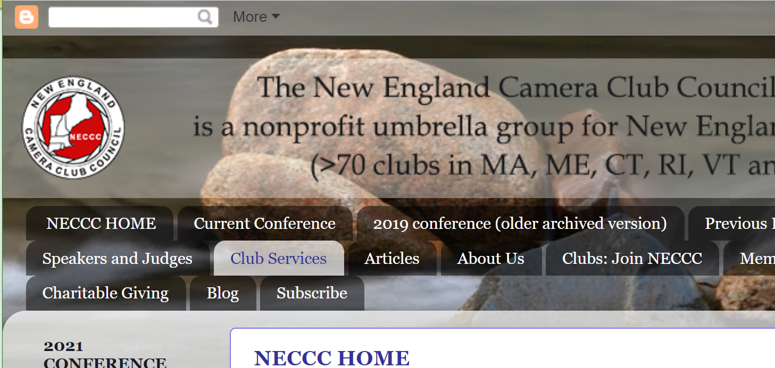
NECCC.org
Club Services

Slide 6

Best of NECCC Prints (Virtual) Was $5.00, As of Oct. 2020, now FREE!
Recorded Programs (Virtual) Was $5.00/program, As of Oct. 2020, now FREE!
Recorded Commentary (Virtual) Was $8.00, As of Oct. 2020, now FREE!
Digital Circuit (Virtual) Was $5.00/category, As of Oct. 2020, now FREE!
Previous low prices have now dropped to FREE!

Slide 7
More Free Services for Program Night Possibilities!
Collection of the Best Photos from NECCC competitions with explanations and critiques
#11 Best of NECCC Photos
Recorded Programs from the NECCC library are available on many Educational Topics – Close-ups, composition, elements to capture… and Photography Topics – Zoos, Birds, Flowers, Nature…
#12 Recorded Programs
Digital Circuits – Your club can participate and receive commentaries you can use as one of your club’s program nights
#26 Digital Circuits
View previous Digital Open and Nature Circuits with commentaries
#12 Recorded Programs
Receive a Recorded Commentary from expert judges on your club’s photos
#13 Recorded Commentary Service

Slide 8
Promote your club and share information between clubs
Other free services
Member Club Rosters
  Use info as a resource to contact other clubs and also to advertise your club! – Lists Club Name, Meeting Locations and Addresses, Meeting Days, Club Size, Presidents and their contact info, Emails and Club Websites, Club Rep information including emails, phone, and address
  #3 NECCC Camera Club Rosters
Promote your club’s photo events on the
NECCC Blog Posts
  #4 Webmaster and Blogmaster Page or
  #20 NECCC – Bulletin – Social Media

Slide 9
Find Judges and Speakers, or apply to be one
Other free services
Apply to be listed as a judge or speaker on the NECCC website
#6 New Judge and/or Speakers List
Speakers List for your club meetings with a wide range of topics including: Landscape, birds, Photoshop, judging, lighting, nature, night and more (Note: Some speakers are free and others charge a fee. Some will offer their presentations virtually. Contact individual speakers directly for details.)
#6 Speakers List
Judges List for your monthly or annual competitions.
#6 Judges List

Slide 10
Get the Latest News
Other free services
Blog Posts and Emails
Subscribe to receive the NECCC Blog emails
#20 NECCC – Bulletin – Social Media
Semi-annual NECCC Bulletin
#20 NECCC – Bulletin – Social Media
Join us on Facebook
#20 NECCC – Bulletin – Social Media

Slide 11
Help and Honor Others
Other free services
NECCC Honor Designation
Submit a candidate to receive an Honor
#14 NECCC Honors
Tax-exempt Charitable Giving
To NECCC.org opportunities
#15 General Operating Fund &
#16 Memorial Fund
Scholarships for college students
#17 Scholarship Application
NECCC Conference tuition and room and board for high school students
#18 High School Student Conference Guest

Slide 12
Low-Cost
Services
Electronic Interclub Competition (Digital)
$5 per category, $10 for both Pictorial (Open) and Nature
#10 Electronic Interclub Competition (Digital)
NECCC Conference Courtesy Enrollment
For a first-time attendee from your club with a $40 co-pay
#5 Application for Courtesy Enrollment

Slide 13
Services currently on Hiatus due to COVID-19
Print Competitions
Print Circuits
In-person NECCC presentations

Slide 14
NECCC is Supporting Member Clubs
We all have to be a bit more creative these days,
but together
we are stronger than ever!

Slide 15
Open discussion on what is working or not working at their clubs
When are in-person meetings resuming
Is membership up or down (fees – up, down, not collecting …)
Is attendance at competition and programs up or down
Fundraising opportunities – Liz Champeon, Eastern Maine Camera Club
What have you tried that is working
What have you tried that is not helping
Using phone photography to recruit new members
What else?

Slide 16
When are in-person meetings resuming?
See poll question
Comments
Wallingford Camera Club is not resuming in-person anytime soon. We meet at a conference center at a hospital.
Boston Camera Club - There is no timetable in place – it depends on the status of the virus

Slide 17
Is membership up or down & fee structure?
See poll question
Comments
Wallingford - Membership is down, but new members have joined. We are collecting same fees we had last year since we had just increased them recently. Programs don’t need membership. Facebook and Instagram. 1 joined. Facebook public viewing, members for comments
Boston - Our attendance since going online has significantly increased
Boston - At certain times we have suggested “Members Bring a Friend” to a meeting. We have gained a few members with this program. Provide friend contact info,
Boston - TRIAL/GUEST membership – on the membership page of the website, one can request a 1-month Guest Membership. Watch weekly Competition and programs
Jim D. local newspaper announcements, announcing upcoming meeting - 4 people contacted, 3 joined, digital
Sue M - newspaper with description of club, generated 3 or 4 members
Rhonda C - scavenger hunts with guest memberships to enter hunt competition, programs open, interested people can request ability to comments

Slide 18
Is attendance at competitions up or down …?
See poll question
Comments
Wallingford - Competition attendance is down.
New Haven - attendance higher
Alan K. less members, same photos
Jim D.

Slide 19
Is attendance at programs up or down …
See poll question
Comments
Wallingford - Programs had some new prospective members although regular member attendance was probably down.
Liz - Could be - connectivity, Linda joining, Cell phone photography, Mark hands on,
Janet - canberry camera club, 15 members, change from night time to daytime club, small field trips, , holiday scavenger hunts,
Linda - monthly challenging
Jim - leaders and learners,
Michael K - somebody don’t want virtual, “gear groups”, independly run

Slide 20
Fundraising opportunities?
Comments
Liz Champeon, Eastern Maine Camera Club has some thoughts
  Charge or not for program nights
  Local garden club - created some booklets on for $5 that is working , what about something like this for a camera
    Calendars, local town brochure, fund raiser with other club (like Lions club), real estate agents handouts on your town, local theater group as audience for dress rehearsal
Wallingford - We only did fundraising in the past through in-person activities like Taste of Wallingford (all activities like this in the area are cancelled until at least May 2021)
Boston - On the Home Page of the website there is a “Donate” button. It’s working ☺

Slide 21
What have you tried that is working?
Comments
Wallingford - We are using Instagram and Facebook some but only about ½ our members use social media for various reasons.
Boston - The “10 minute Social Hour” with which we start our meetings has gotten good feedback and members seem to enjoy it. - Break out rooms for subgroups
Boston - Opening meetings to other clubs has been a great success. Stony Brook has taken a real lead with that
Boston - We are using Instagram to promote the club and members’ work. We are hoping to attract new members through it as well as raise awareness of the club (only running for a month, unknown impact)
Social Facebook, Instagram, Newspaper

Slide 22
What have you tried that is not helping?
Comments
Wallingford - Trying to reach members by emails, but not much response to the emails.
Instagram
Local online newspaper, like the patch
Facebook notices quickly get off your home page
Candi - Members that moved out of state, former members back because we are virtual - what happens we start meeting in person again? Yes we will continue with virtual plus inperson

Slide 23
Using phone photography to recruit new members?
What do you think? Who has tried it?
Comments
Boston - There is a phone photography competition planned for January

